Slide 1
CONTENT DEVELOPMENT AS A CAREER

Slide 2
Content is anything that adds value to the reader’s life

Slide 3
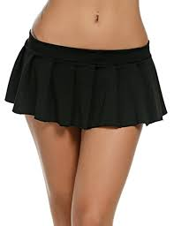
THE GOAL OF ANY CONTENT IS TO COVER THE ESSENTIALS & AROUSE CURIOSITY LIKE A MINI SKIRT
Kappo Emmanuel

Slide 4
Who is a content Developer?
An Artist, Technologist and Scientist

Slide 5
WHAT DOES A CONTENT DEVELOPER DO

Slide 6
They tell powerful compelling stories, that communicates or inform their audience

Slide 7
Content developers are like MTN, you will find them everywhere you go

Slide 8

Who is content Development for?
It is for those that wants to change the world

Slide 9
Critical Skills in Content Development
01
Communication
Analytics
Content Development skills
03
02
Research

Slide 10
What skills do you need?
Bachelor’s degree in computer science, journalism or communication and a minimum of 2-3 years experience in web related marketing and development.
Excellent communications and writing skills
Good listening skills
Research and Analytics
Fairly good knowledge of Design and coding

Slide 11
Thanks!
Any questions?
You can find me at
@rasheedridwon
rasheed@epower.ng
+2348138407613

